Slide 1
cookie

Slide 2
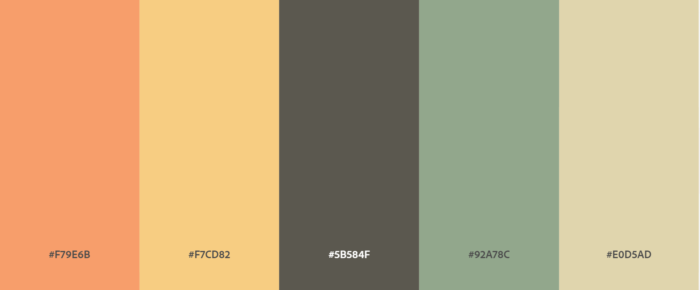
Colors
#F79E6B
#F7CD82
#5B584F
#92A78C
#E0D5AD

Slide 3



Fonts

